Slide 1

Tattoo App using Flutter
Wim Reuvekamp
Arun Pendyala

Slide 2
Overview
Flutter 3.19.2, Dart 3.3.0
Android Studio Iguana | 2023.2.1
View tattoos, purchase related products, or contact an expert

Slide 3
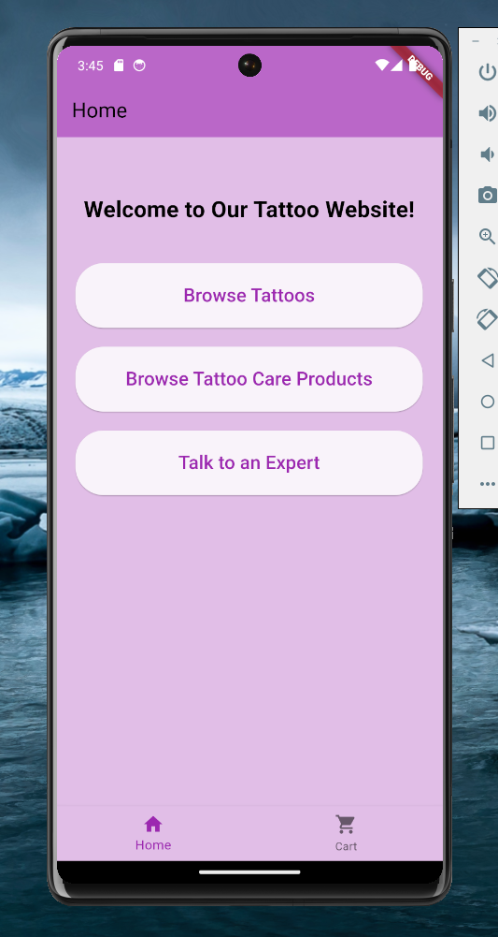
Demonstration

Slide 4
Major changes from our mockup
Added Discount system
Added Billing/Shipping and Payment Page
Dropdown to filter blackwork or color tattoos
Simpler interface for users than two separate pages
This saved time implementing compared to making another near-duplicate page
User can also view all (both) at once

Slide 5
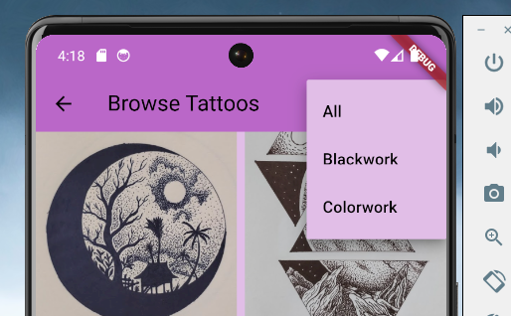
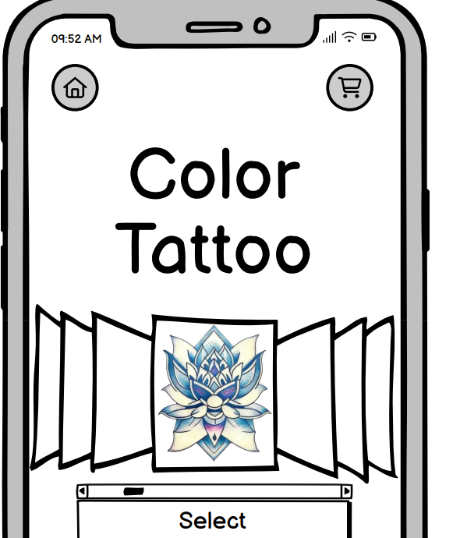
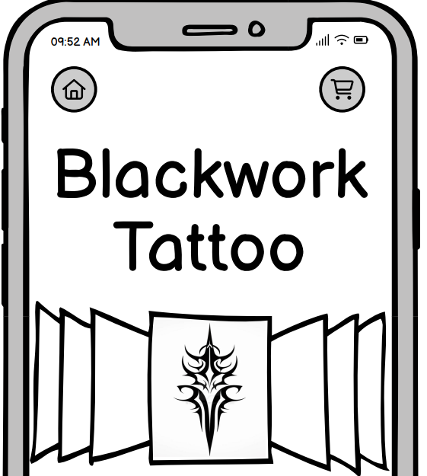
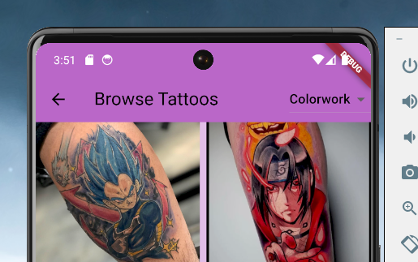
Mockup
(separate pages)
Implementation
(dropdown menu)

Slide 6
Closing thoughts
Future improvements
Review/rating system for tattoos, products, & experts
In-app messaging service
Account or membership system – record payment information, track shipping, exclusive discounts, etc.
Questions or comments
Github Repository: https://github.com/wreuvekamp/Asg3-TattooApp.git

